Slide 1
Tutorial of the Challenge
Virtual Data Generation for Complex Industrial Activity Recognition
12, Dec 2024
Notes:
Hello and welcome, everyone! Today, we’re going to walk through the Virtual Data Generation for Complex Industrial Activity Recognition Tutorial.

Slide 2
Outline
Background of the Challenge
Dataset Overview
Challenge Overview
Sample Notebook Walkthrough
Sample Submission File
Evaluation Criteria
Questions and Answers
Notes:
Please give me 5 to 10 minutes to introduce this challenge.

Slide 3
Background of the Challenge
Emergence of Virtual Data:
Virtual data generation is especially important in Factory Activity Recognition with wearable sensors, where real-world data is often limited and activities are complex. By generating more data, we can reduce data collection efforts with various activities in various scenarios.
Key Technologies Enabling Virtual Data Generation:
Data Augmentations
Generative Adversarial Networks (GANs)
Variational Autoencoders (VAEs)
Diffusion Model
Cross-domain generation (such as IMUTube, IIMUGPU…)
etc.
Challenges in Generating High-Quality Virtual Data:
Source data quality is poor
Data distribution that different from real data
Notes:
Virtual data generation is especially important in Factory Activity Recognition with wearable sensors, where real-world data is often limited and activities are complex. By generating more data, we can reduce data collection efforts with various activities in various scenarios.
Key technologies enabling virtual data generation include data augmentation (which involves modifying existing data to create new, diverse samples), Generative Adversarial Networks (GANs) (which use a generator and discriminator in competition to produce realistic synthetic data), Variational Autoencoders (VAEs) (which encode data into a latent space and decode it to generate variations), diffusion models (which iteratively refine noise into structured data), and more.
Challenges in generating high-quality virtual data include but not limited to poor source data quality and mismatched data distributions compared to real-world data. So, in this challenge, you will need to consider how to generate high-quality virtual data for factory activity recognition.
E.g. GAN, Training a GAN on a small or noisy dataset may result in blurry or distorted synthetic outputs.
Difussion: Improper noise tuning could result in overly noisy or incomplete outputs, making them unusable.

Slide 4
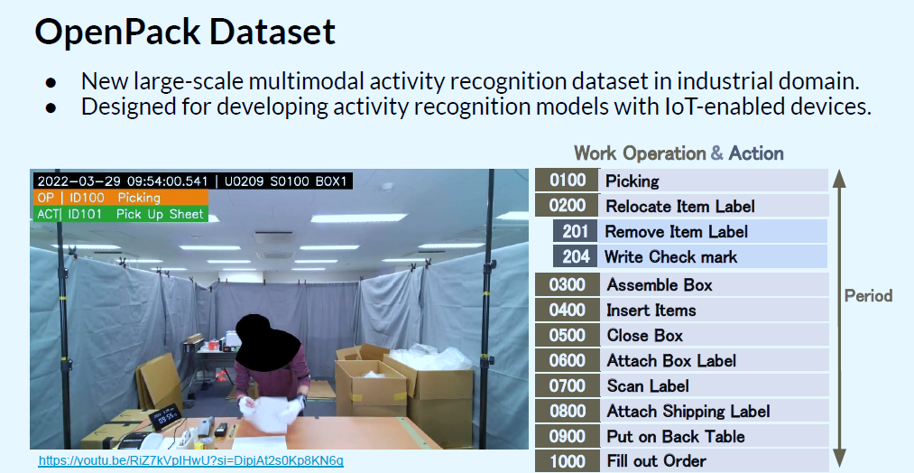
Dataset Overview
In this challenge, we use acceleration data of Scenario 1.
Notes:
In this challenge, we will attempt to use the OpenPack dataset's data to generate new synthetic data, aiming to improve the model's ability to recognize activities.
OpenPack is the first large-scale dataset dedicated to packaging work recognition, including four distinct working scenarios. For this challenge, we will focus on using the sensor data from Scenario 1.
The left figure illustrates the work environment used for data collection.
The right figure depicts the specific activities performed by the worker during the data collection process.

Slide 5
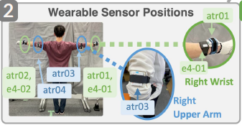
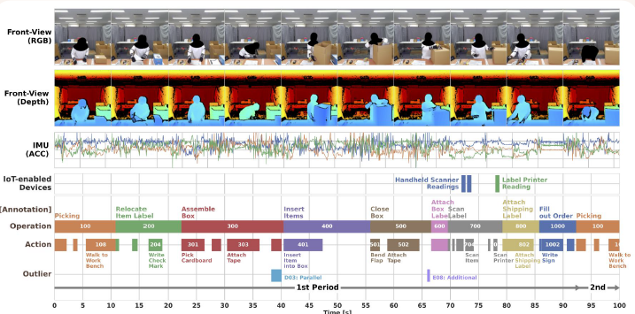
Dataset Overview
In this challenge, we use acceleration data from subjects’ both wrists.
Notes:
Here are the sensor positions and an example of the data. In this challenge, we will use acceleration data collected from sensors placed on the subjects' wrists. Data from both wrists will be utilized for activity recognition and synthetic data generation.

Slide 6
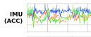
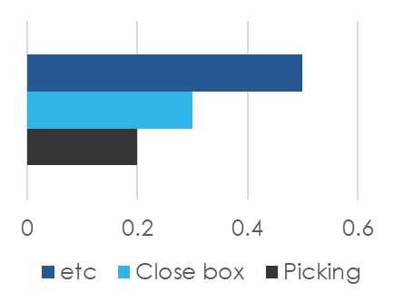
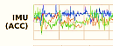
Challenge Overview
Key Objective: Develop virtual data generation methods to improve Human Activity Recognition (HAR) using the OpenPack dataset.
Dataset Features: Acceleration data of subjects’ both wrists in Scenario 1.
Evaluation Metric: F1 score calculated on unseen test data using trained HAR models.
Raw data
Virtual data generation algorithm
HAR model
Virtual data
The only part the participants need to do
Notes:
In this challenge, as shown in the right figure, we will provide you with the raw sensor data and the HAR network. Your task is to design an algorithm to generate virtual data from the raw data to enhance the performance of the HAR model.
You can follow the example code we provide to implement and test your idea effectively.

Slide 7
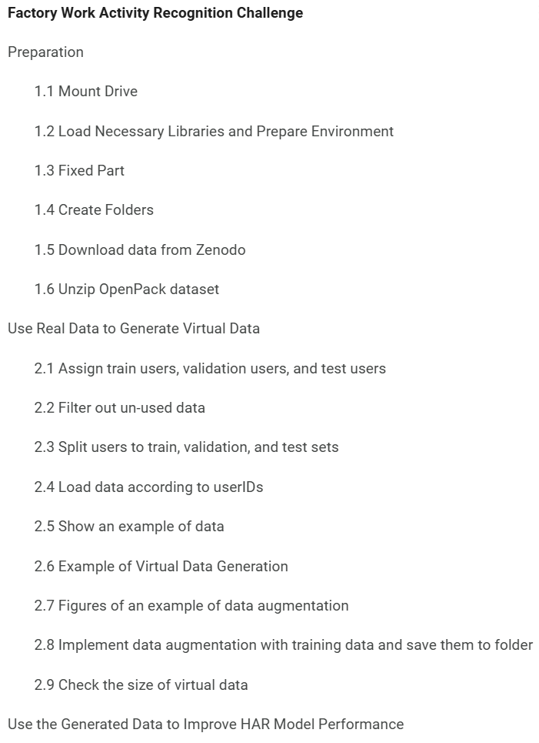
Sample Notebook Walkthrough
Code Availability: Pre-configured Jupyter notebook on Google Colab for quick setup and execution.
Functionality Demonstrated:
Preparation
Use real data to generate virtual data
Use the generated data to improve HAR model performance
Submission code
Ease of Use: Intuitive notebook design allows participants to modify code and test their ideas.
Design your code here
Check the size of generated data
Notes:
The code consists of three main components:
Preparation: This component handles the extraction of raw sensor data from the OpenPack dataset. It ensures that the raw data is loaded correctly and prepared for further processing.
Use real data to generate virtual data: In this component, you will modify the code to design an algorithm for generating virtual data from the real OpenPack data. Your task is to:
Implement your data generation logic here.
Save the generated virtual data in the correct CSV format and at the specified path.
Use the generated data to improve HAR model performance: This component tests whether the virtual data enhances the HAR model's performance. You can:
Adjust random seeds and data split ratios to verify the robustness of your code.
But: You are not required to modify the model structure; focus only on improving the data input.

Slide 8
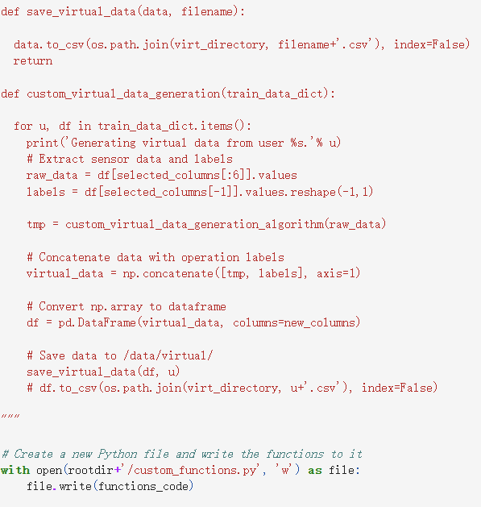
Sample Submission File
Submission Format: Participants must submit (1) a `.py` file containing virtual data generation functions that relate to “custom_virtual_data_generation” function and (2) the generated virtual data.
Required Details:
Keeping unchanged of the input and output of “custom_virtual_data_generation” function.
Save the virtual data in correct format (next slide).
File size of generated data located at “virtual” directory should be limited to 500MB.
Compatibility: Need be executable in Google Colab, with output saved in designated paths. But participants can run their codes on their own computers.
Don’t change the input
Notes:
You need to submit both the generated virtual data and all the relevant python code used to generate the virtual data.
Ensure that you don’t change the input and output of the “custom_virtual_data_generation” function, as we will use this function to evaluate your data generation algorithm. Additionally, ensure that the size of the generated virtual data is less than 500 MB and is saved in the correct format.

Slide 9
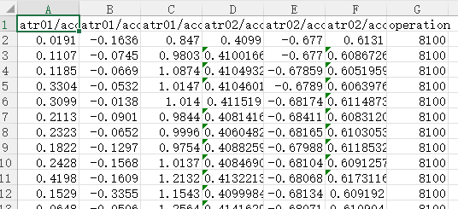
Sample Submission File
Submission Format: Participants must submit (1) a `.py` file containing virtual data generation functions that relate to “custom_virtual_data_generation” function and (2) the generated virtual data.
Required Details:
Keeping unchanged of the input and output of “custom_virtual_data_generation” function.
Save the virtual data in correct format (next slide).
File size of generated data located at “virtual” directory should be limited to 500M.
Compatibility: Need be executable in Google Colab, with output saved in designated paths. But participants can run their codes on their own computers.
Example of virtual data format (.csv file)
Accel. Left wrist
Accel. right wrist
Label
Notes:
The virtual data can be saved using the “save_virtual_data” function as a CSV file. In the CSV file, there are 7 columns: the first three columns contain the generated acceleration data for the left wrist, columns 4 to 6 contain the data for the right wrist, and the last column contains the activity label.

Slide 10
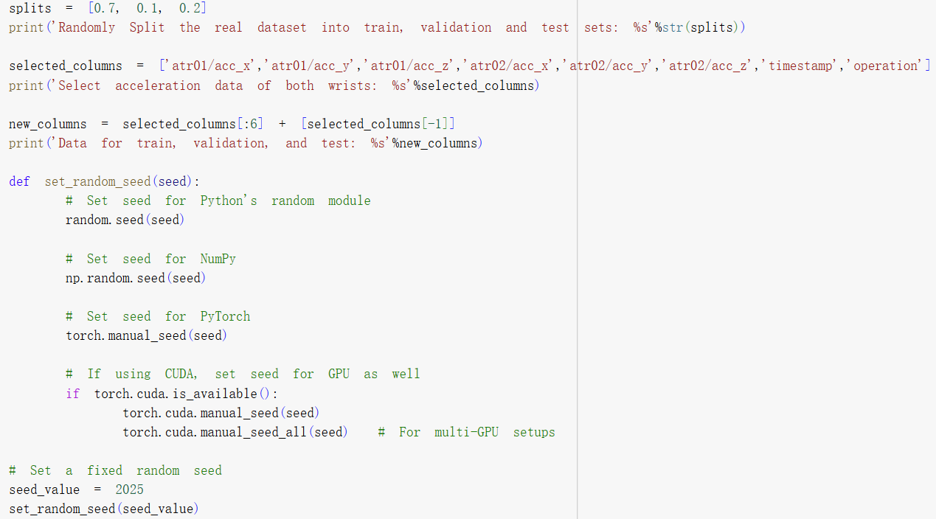
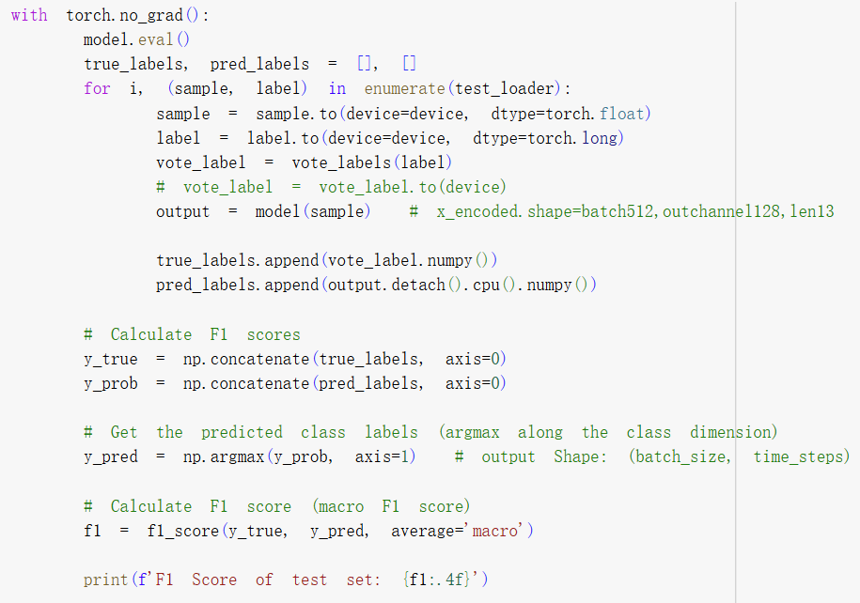
Evaluation and Judging Criteria
F1 Score as Core Metric: Virtual data quality evaluated by improvements in HAR model performance on test data.
Testing Setup: HAR model trained on generated data and tested using different random seeds with different test data of the OpenPack dataset.
Fairness Measures: All algorithms evaluated under the same conditions to ensure comparability.
This part will be changed and made private.
Evaluate with F1 score.
Notes:
During evaluation, we will call the “custom_virtual_data_generation” function you provided to train the model, and calculate F1 score. We will change the random seed and split portion of the OpenPack dataset. Therefore, ensure that your data generation algorithm performs well under various settings.

Slide 11
Q&A Both English and Japanese are fine
Notes:
Thank you for your attention! I'm happy to answer any questions you might have.

